Slide 1
Chapter 3
P5 Micro architecture : Intel’s Fifth generation

Slide 2
Features of Pentium
Introduced in 1993 with clock frequency ranging from 60 to 66 MHz
The primary changes in Pentium Processor were:
Superscalar Architecture
Dynamic Branch Prediction
Pipelined Floating-Point Unit
Separate 8K Code and Data Caches
Writeback MESI Protocol in the Data Cache
64-Bit Data Bus
Bus Cycle Pipelining

Slide 3
Pentium Architecture
UQ: Explain with block diagram how superscalar operation is carried out in Pentium Processor
UQ: Draw and explain Pentium Processor architecture . Highlight architectural features

Slide 4
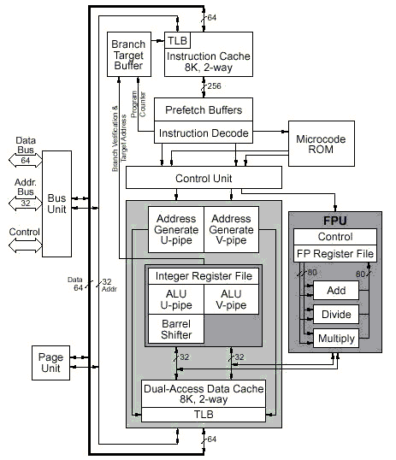

Slide 5
Pentium Architecture
It has data bus of 64 bit and address bus of 32-bit
There are two separate 8kB caches – one for code and one for data.
Each cache has a separate address translation TLB which translates linear addresses to physical.
Code Cache:
It is an 8KB cache dedicated to supply instructions to processor’s execution pipeline
2 way set associative cache with a line size of 32 bytes
256 lines b/w code cache and prefetch buffer, permits prefetching of 32 bytes (256/8) of instructions

Slide 6
Pentium Architecture
Prefetch Buffers:
Four prefetch buffers within the processor works as two independent pairs.
When instructions are prefetched from cache, they are placed into one set of prefetch buffers.
The other set is used as when a branch operation is predicted.
Prefetch buffer sends a pair of instructions to instruction decoder

Slide 7
Pentium Architecture
Instruction Decode Unit:
It occurs in two stages – Decode1 (D1) and Decode2(D2)
D1 checks whether instructions can be paired
D2 calculates the address of memory resident operands

Slide 8
Pentium Architecture
Control Unit :
This unit interprets the instruction word and microcode entry point fed to it by Instruction Decode Unit
It handles exceptions, breakpoints and interrupts.
It controls the integer pipelines and floating point sequences
Microcode ROM :
Stores microcode sequences

Slide 9
Pentium Architecture
Arithmetic/Logic Units (ALUs) :
There are two parallel integer instruction pipelines: u-pipeline and v-pipeline
The u-pipeline has a barrel shifter
The two ALUs perform the arithmetic and logical operations specified by their instructions in their respective pipeline

Slide 10
Pentium Architecture
Address Generators :
Two address generators (one for each pipeline) form the address specified by the instructions in their respective pipeline.
They are equivalent to segmentation unit.
Paging Unit :
If enabled, it translates linear address (from address generator) to physical address
It can handle two linear addresses at the same time to support both pipelines with one TLB per cache

Slide 11
Pentium Architecture
Floating Point Unit:
It can accept upto two floating point operations per clock when one of the instruction is an exchange instruction
Three types of floating point operations can operate simultaneously within FPU: addition, division and multiplication.

Slide 12
Pentium Architecture
Data Cache:
It is an 8KB write-back , two way set associative cache with line size of 32 bytes

Slide 13
Pentium Architecture
Bus Unit:
Address Drivers and Receivers:
Push address onto the processor’s local address bus (A31:A3 and BE7:BE0)
Data Bus Transceivers:
gate data onto/into the processor ‘s local data bus
Bus Control Logic:
controls whether a standard (8/16/32bits)or burst(32bytes) bus cycle is to be run

Slide 14
Pentium Architecture
Branch Target Buffer: supplies jump target prefetch addresses to the code cache

Slide 15
Superscalar Operation
The prefetcher sends an address to code cache and if present, a line of 32 bytes is send to one of the prefetch buffers
The prefetch buffer transfers instructions to decode unit
Initially it checks if the instructions can be paired.

Slide 16
Superscalar Operation
If paired, one goes to ‘u’ and other goes to ‘v’ pipeline as long as no dependencies exist between them.
Pair of instructions enter and exit each stage of pipeline in unison

Slide 17
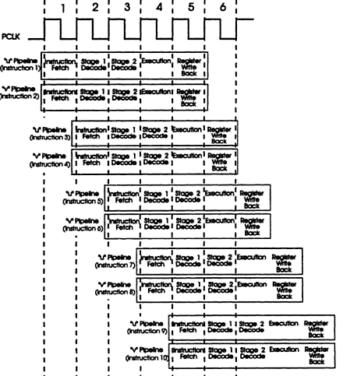
Superscalar Operation
Pentium uses a five stage execution pipeline as shown:

Slide 18
Integer Pipeline
UQ: Explain in brief integer instruction pipeline stages of Pentium

Slide 19
Integer Pipeline
The pipelines are called “u” and “v” pipes.
The u-pipe can execute any instruction, while the v-pipe can execute “simple” instructions as defined in the “Instruction Pairing Rules”.
When instructions are paired, the instruction issued to the v-pipe is always the next in sequential after the one issued to u-pipe.

Slide 20
Integer Pipeline
The integer pipeline stages are as follows:
Prefetch(PF) :
Instructions are prefetched from the on-chip instruction cache
Decode1(D1):
Two parallel decoders attempt to decode and issue the next two sequential instructions
It checks whether the instructions can be paired
It decodes the instruction to generate a control word

Slide 21
Integer Pipeline
A single control word causes direct execution of an instruction
Complex instructions require microcoded control sequencing
3. Decode2(D2):
Decodes the control word
Address of memory resident operands are calculated

Slide 22
Integer Pipeline
Execute (EX):
The instruction is executed in ALU
Data cache is accessed at this stage
For both ALU and data cache access requires more than one clock.
Writeback(WB):
The CPU stores the result and updates the flags

Slide 23
Integer Instruction Pairing Rules
UQ: Explain the instruction pairing rules for Pentium

Slide 24
Integer Instruction Pairing Rules
To issue two instructions simultaneously they must satisfy the following conditions:
Both instructions in the pair must be “simple”.
There must be no read-after-write(RAW) or write-after-write register(WAW) dependencies
RAW:
i1. R2 ← R1 + R3 i2. R4 ← R2 + R3
WAW:
i1. R2 ← R4 + R7 i2. R2 ← R1 + R3

Slide 25
Integer Instruction Pairing Rules
Neither instruction may contain both a displacement and an immediate
Instruction with prefixes (e.g.lock,repne) can only occur in the u-pipe

Slide 26
Simple Instructions
They are entirely hardwired
They do not require any microcode control
Executes in one clock cycle
Exception: ALU mem,reg and ALU reg,mem are 3 and 2 clock operations respectively

Slide 27
The following integer instructions are considered simple and may be paired:
1. mov reg, reg/mem/imm
2. mov mem, reg/imm
3. alu reg, reg/mem/imm
4. alu mem, reg/imm
5. inc reg/mem
6. dec reg/mem
7. push reg/mem
8. pop reg
9. lea reg,mem
10. jmp/call/jcc near
11. nop
12. test reg, reg/mem
13. test acc, imm

Slide 28
UQ: List the steps in instruction issue algorithm

Slide 29
Instruction Issue Algorithm
Decode the two consecutive instructions I1 and I2
If the following are all true
I1 and I2 are simple instructions
I1 is not a jump instruction
Destination of I1 is not a source of I2
Destination of I1 is not a destination of I2
Then issue I1 to u pipeline and I2 to v pipeline
Else issue I1 to u pipeline

Slide 30
Floating Point Pipeline
UQ: Explain the floating point pipeline stages.

Slide 31
Floating-Point Pipeline
The floating point pipeline has 8 stages as follows:
Prefetch(PF) :
Instructions are prefetched from the on-chip instruction cache
Instruction Decode(D1):
Two parallel decoders attempt to decode and issue the next two sequential instructions
It checks whether the instructions can be paired
It decodes the instruction to generate a control word

Slide 32
Floating-Point Pipeline
A single control word causes direct execution of an instruction
Complex instructions require microcoded control sequencing
3. Address Generate (D2):
Decodes the control word
Address of memory resident operands are calculated

Slide 33
Floating-Point Pipeline
Memory and Register Read (Execution Stage) (EX):
Register read or memory read performed as required by the instruction to access an operand.
Floating Point Execution Stage 1(X1):
Information from register or memory is written into FP register.
Data is converted to floating point format before being loaded into the floating point unit

Slide 34
Floating-Point Pipeline
Floating Point Execution Stage 2(X2):
Floating point operation performed within floating point unit.
Write FP Result (WF):
Floating point results are rounded and the result is written to the target floating point register.
Error Reporting(ER)
If an error is detected, an error reporting stage is entered where the error is reported and FPU status word is updated

Slide 35
Instruction Issue for Floating Point Unit
The rules of how floating-point (FP) instructions get issued on the Pentium processor are :
FP instructions do not get paired with integer instructions.
When a pair of FP instructions is issued to the FPU, only the FXCH instruction can be the second instruction of the pair.
The first instruction of the pair must be one of a set F where F = [ FLD,FADD, FSUB, FMUL, FDIV, FCOM, FUCOM, FTST, FABS, FCHS].
FP instructions other than FXCH and instructions belonging to set F, always get issued singly to the FPU.
FP instructions that are not directly followed by an FXCH instruction are issued singly to the FPU.

Slide 36
Branch Prediction Logic
UQ : Explain how the flushing of pipeline can be minimised in Pentium Architecture

Slide 37
Flushing of pipeline problem
Performance gain through pipelining can be reduced by the presence of program transfer instructions (such as JMP,CALL,RET and conditional jumps).
They change the sequence causing all the instructions that entered the pipeline after program transfer instruction invalid.

Slide 38
Flushing of pipeline problem
Suppose instruction I3 is a conditional jump to I50 at some other address(target address), then the instructions that entered after I3 is invalid and new sequence beginning with I50 need to be loaded in.
This causes bubbles in pipeline, where no work is done as the pipeline stages are reloaded.
This is called flushing of pipeline problem.

Slide 39
Flushing of pipeline problem
To avoid this problem, the Pentium uses a scheme called Dynamic Branch Prediction.
In this scheme, a prediction is made concerning the branch instruction currently in pipeline.
Prediction will be either the branch is taken or not taken.
If the prediction turns out to be true, the pipeline will not be flushed and no clock cycles will be lost.

Slide 40
Flushing of pipeline problem
If the prediction turns out to be false, the pipeline is flushed and started over with the correct instruction.
It results in a 3 cycle penalty if the branch is executed in the u-pipeline and 4 cycle penalty in v-pipeline.

Slide 41
Dynamic Branch Prediction Mechanism
It is implemented using a 4-way set associative cache with 256 entries. This is referred to as the Branch Target Buffer(BTB).
The directory entry (tag) for each line contains the following information:
Valid Bit : Indicates whether or not the entry is in use
History Bits: track how often the branch has been taken
Source memory address that the branch instruction was fetched from (address of I3)

Slide 42
Dynamic Branch Prediction Mechanism
If its directory entry is valid, the target address of the branch (address of I50) is stored in corresponding data entry in BTB

Slide 43
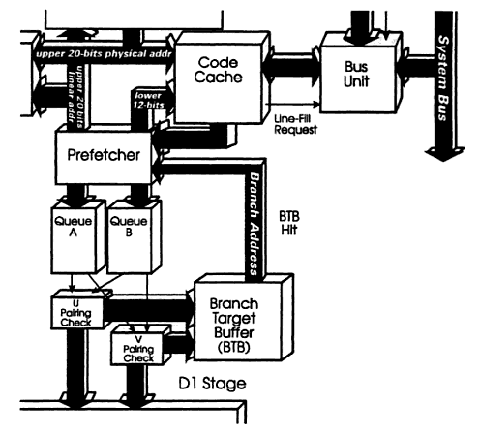
The Branch Target Buffer

Slide 44
Dynamic Branch Prediction Mechanism
BTB is a look-aside cache that sits off to the side of D1 stages of two pipelines and monitors for branch instructions.
The first time that a branch instruction enters either pipeline, the BTB uses its source memory address to perform a lookup in the cache.
Since the instruction has not been seen before, this results in a BTB miss.

Slide 45
Dynamic Branch Prediction Mechanism
It means the prediction logic has no history on instruction.
It then predicts that the branch will not be taken and program flow is not altered.
Even unconditional jumps will be predicted as not taken the first time that they are seen by BTB.

Slide 46
Dynamic Branch Prediction Mechanism
When the instruction reaches the execution stage, the branch will be either taken or not taken.
If taken, the next instruction to be executed should be the one fetched from branch target address.
If not taken, the next instruction is the next sequential memory address.

Slide 47
Dynamic Branch Prediction Mechanism
When the branch is taken for the first time, the execution unit provides feedback to the branch prediction logic.
The branch target address is sent back and recorded in BTB.
A directory entry is made containing the source memory address and history bits set as strongly taken

Slide 48
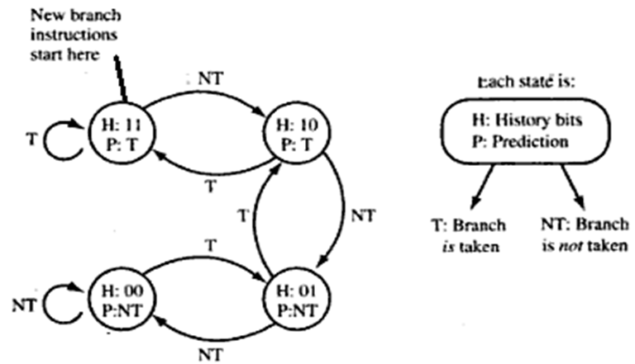
Dynamic Branch Prediction Mechanism
Strongly Taken
Weakly Taken
Strongly Not Taken
Weakly Not Taken

Slide 49
Dynamic Branch Prediction Mechanism
History Bits | Resulting Description | Prediction Made | If branch is taken | If branch is not taken
11 | Strongly Taken | Branch Taken | Remains Strongly Taken | Downgrades to Weakly Taken
10 | Weakly Taken | Branch Taken | Upgrades to Strongly Taken | Downgrades to Weakly Not Taken
01 | Weakly Not Taken | Branch Not Taken | Upgrades to Weakly Taken | Downgrades to Strongly Not Taken
00 | Strongly Not Taken | Branch Not Taken | Upgrades to Weakly Not Taken | Remains Strongly Not Taken

Slide 50
D1 Stage checks whether branch?
yes
Checks for entry in BTB
yes
no
BTB Hit ?
yes
Prediction is Br taken ?
no
Next address← target address
Next address← Seq. address

Slide 51
Prediction is correct ?
yes
no
No Flushing
Flushing of Pipeline

